Slide 1
Innovations in Jail-Based Competency Restoration
Kenneth Carabello, MSW, Senior Vice President
Melissa Tran-Chamblin, LMFT, Executive Director

Slide 2
Disclosure & Disclaimer Statement
We have the following relevant financial relationship with a commercial interest:
We are a vendor to states and counties that wish to provide competency restoration services.
© 2023 Liberty Healthcare Corporation and All Liberty Affiliated Companies. All Rights Reserved. Proprietary and Confidential. Do Not Reproduce Without Permission.

Slide 3
Learning Objectives
Discuss
Review
Compare
Discuss the primary objectives of the jail-based competency treatment model for augmenting state forensic hospitalization
Review the potential advantages of hosting a jail-based competency treatment program
Compare Early Access and Stabilization Services and off-ramping models

Slide 4
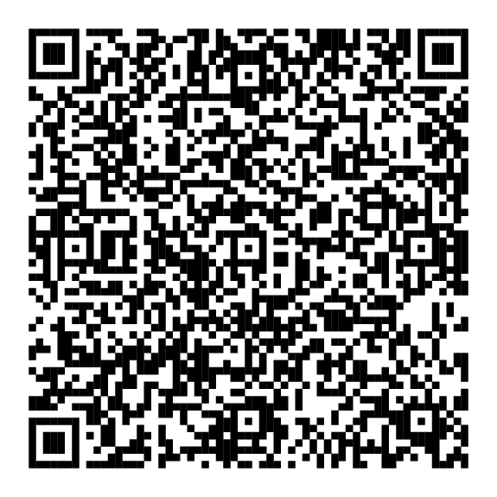

Let’s Connect
Ken Carabello, MSW
Senior Vice President
Melissa Tran-Chamblin, LMFT
Executive Director, CA EASS Program
Scan the QR code to add us to your contacts

Slide 5
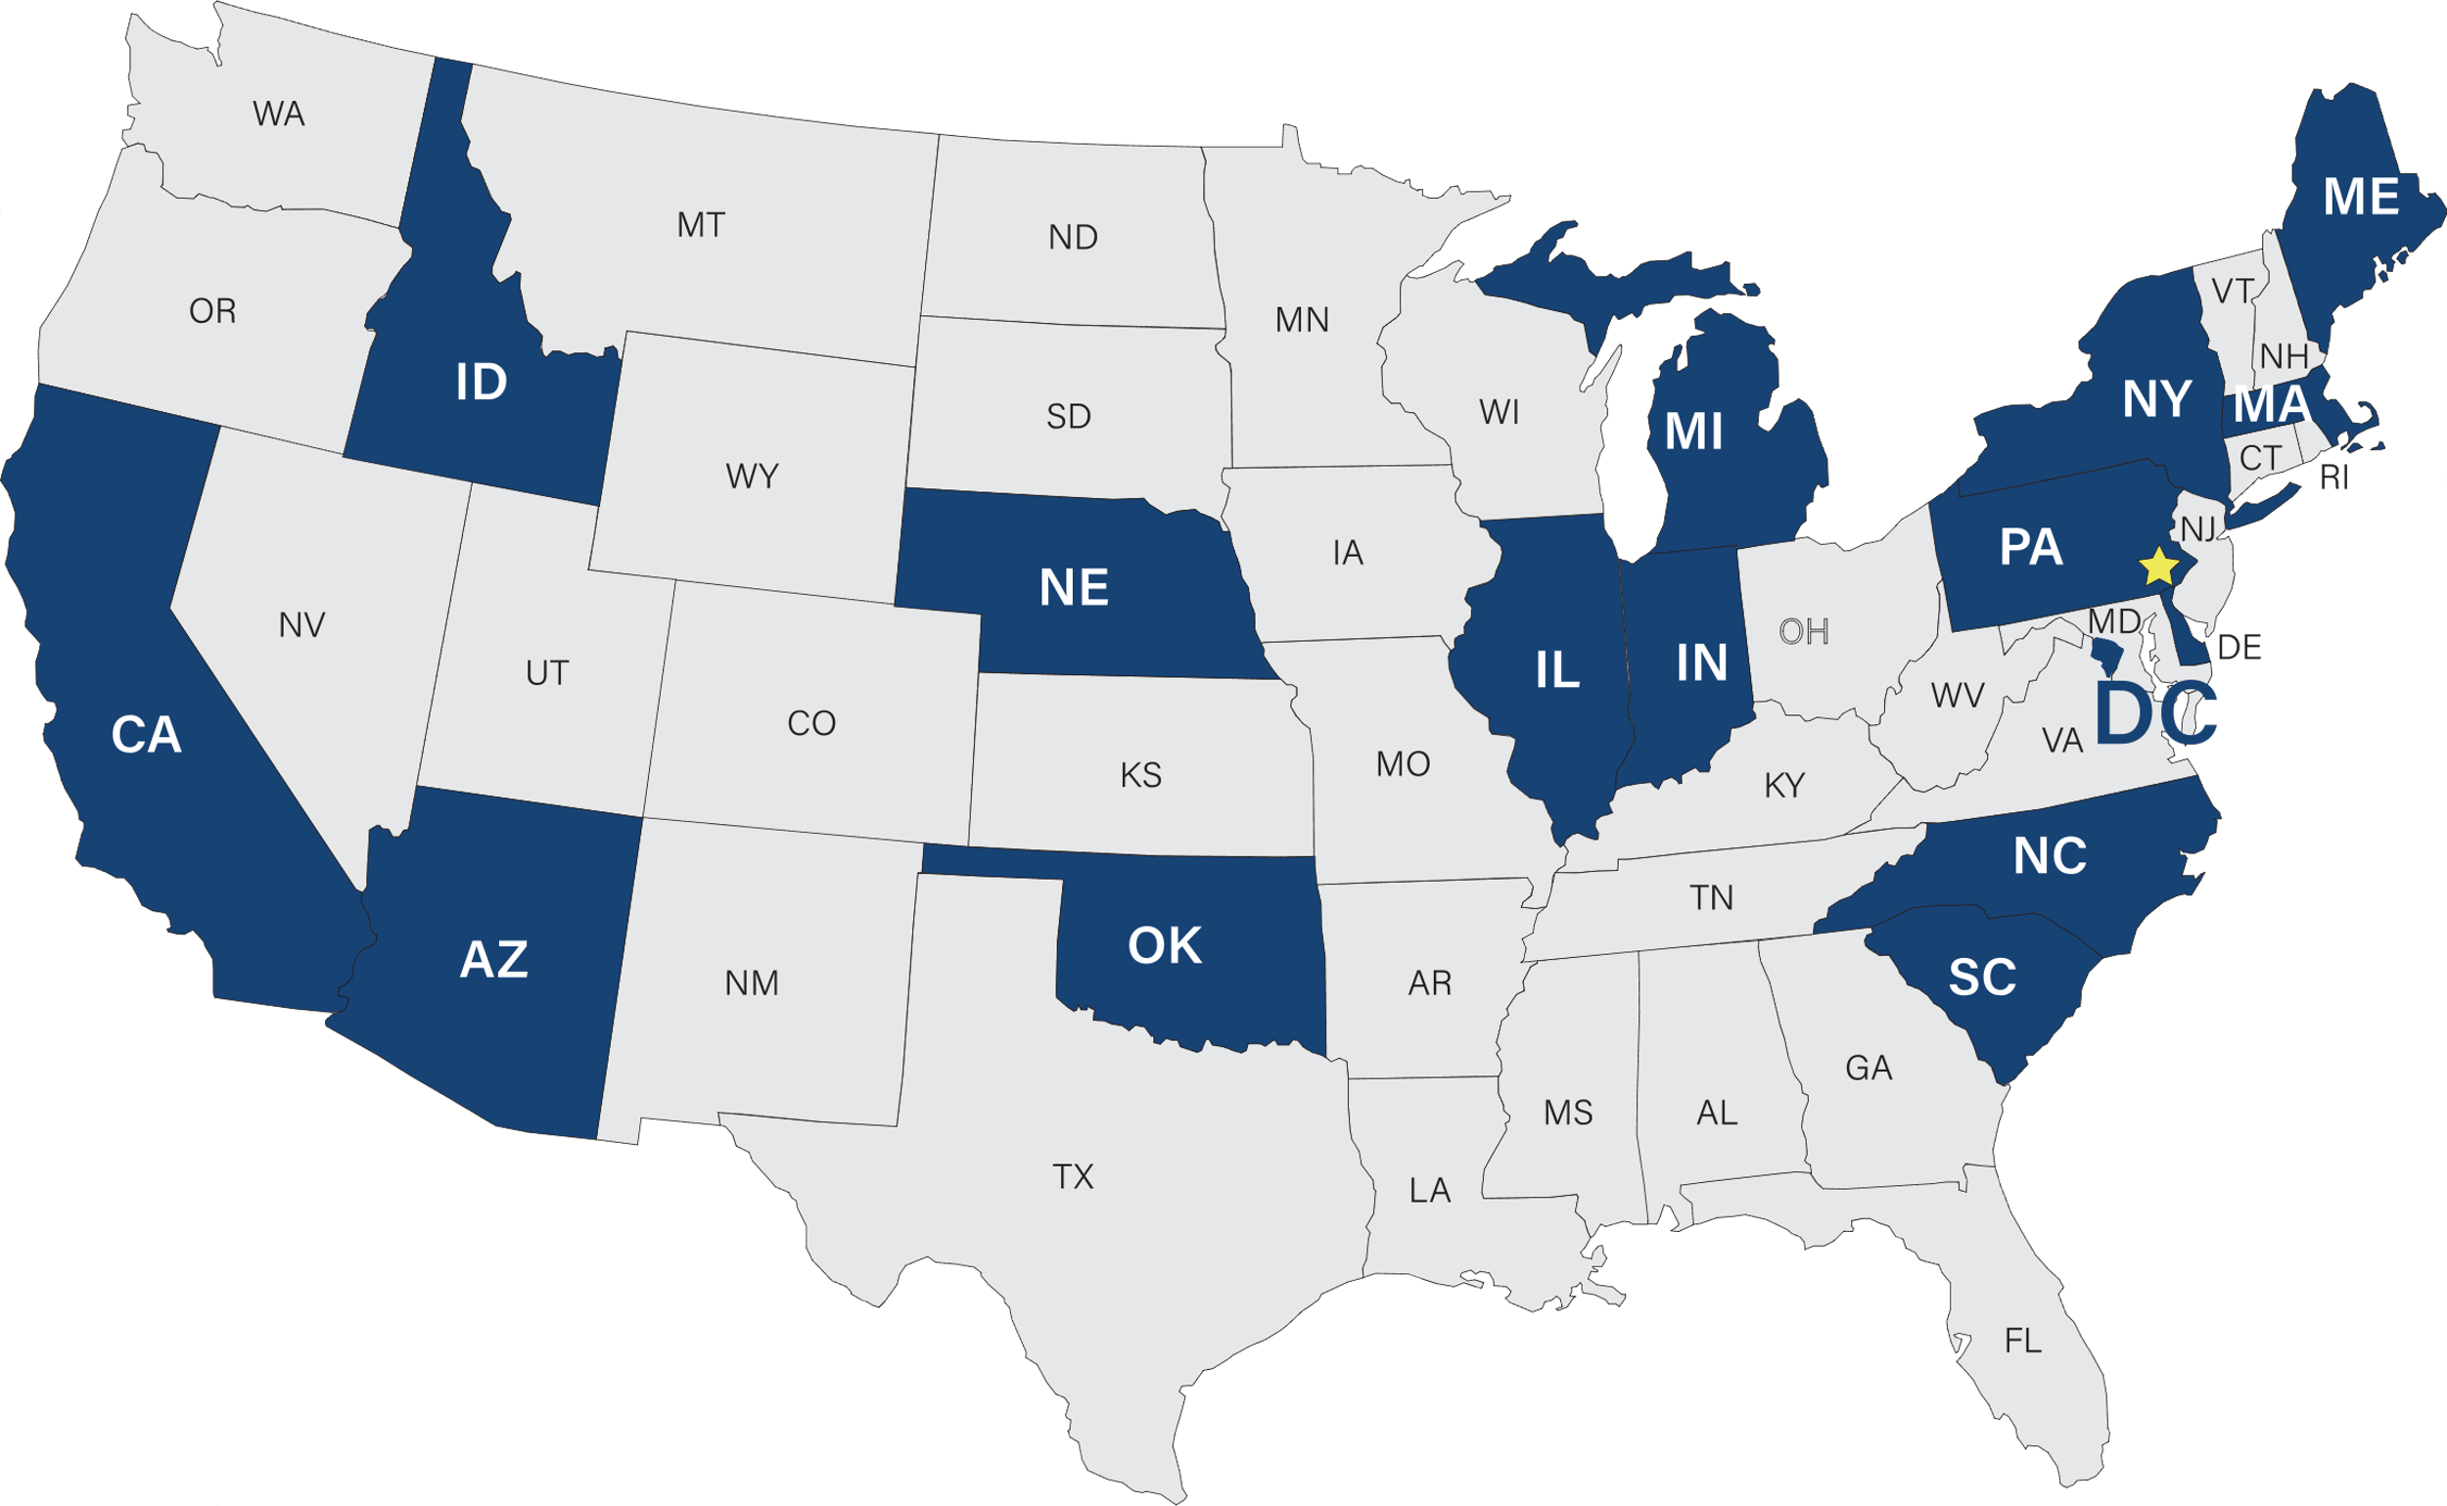




36+ Years
1300+ Employees
Liberty Healthcare Corporation
Behavioral Health Justice Involved
Intellectual/Developmental Disability
Aging & Disability
The Freedom to Succeed

Slide 6
History and Context – the “Competency Services Crisis”
Nationally, 25% increase individuals who are Incompetent to Stand Trial (IST) from 1999 to 2005
Nationally, 37% increase from 2006 to 2014
Since 2014, even higher rates of IST increases!
Liberty pioneers “ROC” model from 1997 to 2003
2010 – Liberty brings ROC model to California DSH

Slide 7
prorated

Slide 8
Liberty’s History on Restoration of Competency
VA Forensic Unit at Riverside Reg Jail 1997 - 2003
CA Restoration of Competency (ROC) 2010 - 2017
CA Jail Based Competency Treatment (JBCT) 2015 - Present
CA Off Ramping 2021 - canceled
CA Early Access and Stabilization Services (EASS) 2022 - Present
IN Jail Based Competency Restoration (JBCR) Pending

Slide 9
Lawsuits
Washington
Stiavetti

Slide 10
Continuum of Competency Interventions
Incompetent to Stand Trial (IST) Treatment Pathways
( Average wait time from commitment to JBCT/State Hospital admission: 4-6 Months)
Committed to treatment as Incompetent to Stand Trial by courts
Early Access & Stabilization Services (EASS)
DSH IST Re-Evaluation Program
Jail-Based Competency Treatment (JBCT)
Diversion or Community-Based Restoration (CBR)
State Hospital

Slide 11
Early Access & Stabilization Services (EASS)
Early Access and Stabilization Services (EASS), in partnership with the Department of State Hospitals (DSH), provides treatment services to Incompetent to Stand Trial (IST) incarcerated patients.
Our goal is to provide early patient engagement​, psychiatric medication stabilization​, and competency restoration at the earliest point possible after commitment while awaiting admission to a DSH facility (e.g., JBCT or State Hospital)​.
Services includes weekly psychiatric medication management including long-acting injectable medication, weekly individualized mental health and competency restoration treatment, and daily contacts for assessment and monitoring of psychiatric stabilization.

Slide 12

Locations
San Bernardino
West Valley Detention Center
Program Start Date: 09/26/22
Riverside
West Valley Detention Center
Program Start Date: 09/26/22
Robert Presley
Detention Center
Program Start Date: 12/5/22
San Diego
San Diego Central Jail & Las Colinas Detention Re-Entry Program Start Date: 8/16/23

Slide 13

Operating Hours
Monday – Friday 8:00am – 4:30pm
Saturday – Sunday 8:00am – 4:30pm
Program Manager
Admin Assistant
Psychiatrists
Nursing Supervisor
LVNs/ Psych Techs
Clinicians
Competency Trainers
LVNs/ Psych Techs

Slide 14
Staffing
  Location Staff
    Program Manager
    Administrative Assistant
    Psychiatrists (virtual)
    Nursing Supervisor
    Psych Techs/LVNs
    Forensic Psychologists (PRN) (virtual)
    Clinicians
    Competency Trainers
  Non Local Staff
    Executive Director
    Chief Psychiatrist
    Program Analyst

Slide 15






EASS Treatment Services
Individualized clinical encounter – minimal 3 times weekly
Weekly psychiatric/mental health assessment & treatment
Weekly competency restoration education
Competency evaluation by psychologist as required by court and as needed
Administration of long-acting injectable medication
Weekly contact (minimum 3 contacts/week) by Psych Tech/LVN

Slide 16
Services and Timeline
ra
Services
  Services begin no later than 3 business days from Enrollment Date (Managed by Clinician)
  Minimum 3 times per week
  Psychiatric Medication Stabilization
    Weekly Assessment & medication management 1:1 encounter by Psychiatric Prescriber
    Weekly 1:1 encounter (minimal 3x per week) by LVNs/Psych Techs
  Mental Health Management
    Weekly 1:1 minimal encounter by Clinician
  Competency Restoration
    Weekly 1:1 minimal encounter by Competency Trainer and Clinician
r
  Completed by a Clinician
    Includes psychiatric medication management, mental health and competency restoration (Collaboration with Psychiatric Prescriber and Competency Trainer)
  Initial Tx Plan completed within 5 business days following the psychiatric provider's initial evaluation (10 days from Initial Participation Date)
  Updated every 30 days
Initial Assessment/ Treatment
  DSH SharePoint
    Waitlist
    Referral Package
  Initial Participation Date
  AA assign Case to Clinician & Schedule first Psychiatrist Appointment
  Records Review within 2 business days by:
      Clinician
      Nurse Supervisor
  Services begin no later than 3 business days
  Nursing Assessment within 3 business days
  Psychiatric Initial Evaluation by Psychiatric Prescriber within 5 days
    Notify DSH if IMO needed within 5 business days
  Psychosocial Initial Assessment by Clinician within 5 days
  1:1 Encounter by Competency Trainer within 5 days
  JBCT/ State Hospital
  Community Based Restoration / Diversion
  Restored/ Return to Court
Un-enrollment
Enrollment
Treatment Plan
© 2023 Liberty Healthcare Corporation and All Liberty Affiliated Companies. All Rights Reserved. Proprietary and Confidential. Do Not Reproduce Without Permission.

Slide 17
Treatment Team Meeting & Case Conference
  Treatment Team Meeting
  Weekly meeting: Liberty Treatment Team to report and discuss patient’s progress
  Treatment Team members:
    Program Manager
    Clinicians
    Competency Trainers
    Psychiatrist
    Nursing Supervisor
    LVNs/Psych Techs
  DSH Case Conference
  Weekly meeting: : Liberty Treatment Team, DSH PMU to report and discuss patient’s progress

Slide 18
Outcomes: Enrollment
Committing County | Average Daily Census | Male Enrollments | Female Enrollments | Total Enrollments | Average Time from Enrollment to Services | Average time on Waitlist (days)
Riverside | 16.7 | *** | ** | 178 | 1.2 | 40.0
San Bernardino | 17.0 | 218 | 63 | 281 | 0.7 | 23.3
San Diego | 21.0 | ** | <11 | 33 | 9.8 | 18.3
TOTAL | 16.8 | 378 | 114 | 492 | 1.2 | 28.5
Data as of 9/7/23

Slide 19
Outcomes: Enrollment Details
Month | Average Daily Census | Male Enrollments | Female Enrollments | Total Enrollments | Average Time from Enrollment to Services | Average time on Waitlist (days)
September 2022 | <11 | <11 | <11 | <11 | 1.2 | 69.0
October 2022 | <11 | ** | <11 | 23 | 0.4 | 62.8
November 2022 | 17.0 | ** | <11 | 22 | 0.8 | 35.4
December 2022 | 32.4 | 33 | <11 | ** | 0.7 | 46.8
January 2023 | 37.1 | 37 | 12 | 49 | 0.8 | 35.5
February 2023 | 36.4 | 35 | 11 | 46 | 0.5 | 28.0
March 2023 | 39.1 | ** | <11 | 29 | 0.2 | 30.4
April 2023 | 30.0 | ** | <11 | 34 | 0.6 | 30.3
May 2023 | 28.3 | 31 | 11 | 42 | 0.4 | 22.4
June 2023 | 24.5 | ** | <11 | 34 | 0.5 | 24.7
July 2023 | 32.4 | 51 | 17 | 68 | 1.0 | 21.4
August 2023 | 57.1 | 65 | 23 | 88 | 4.0 | 9.2
September 2023 | 68.3 | <11 | <11 | 11
TOTAL | 31.9 | 378 | 114 | 492 | 1.2 | 28.5
Data as of 9/7/23

Slide 20
Outcomes: Un-Enrollment
Committing County | Male Un-enrollments | Female Un-enrollments | Total Un-enrollments | Average Length of Stay (days)
Riverside | *** | ** | 139 | 22.6
San Bernardino | 208 | 62 | 270 | 20.0
San Diego | ** | <11 | 15 | 6.8
TOTAL | 329 | 95 | 424 | 20.6
Data as of 9/7/23

Slide 21
Outcomes: Un-Enrollment Details
Month | Male Un-enrollments | Female Un-enrollments | Total Un-enrollments | Average Length of Stay (days)
September 2022 | <11 | 0 | <11 | 1.0
October 2022 | <11 | <11 | 14 | 13.5
November 2022 | <11 | <11 | 14 | 19.9
December 2022 | ** | <11 | 30 | 25.6
January 2023 | ** | <11 | 43 | 23.0
February 2023 | 30 | 13 | 43 | 21.8
March 2023 | 32 | 11 | 43 | 25.0
April 2023 | ** | <11 | 38 | 29.9
May 2023 | 27 | 12 | 39 | 20.6
June 2023 | ** | <11 | 37 | 19.5
July 2023 | ** | <11 | 49 | 15.2
August 2023 | 51 | 14 | 65 | 14.0
September 2023 | <11 | <11 | <11 | 12.3
TOTAL | 329 | 95 | 424 | 20.6
Data as of 9/7/23

Slide 22
Outcomes: Un-Enrollment Pathways
Committing County | Total Transferred to SH | Total Transferred to JBCT | Total Transferred to Jail-Restored | Total Transferred to Jail-Non-restorable | Total Transferred to Jail-Max Commitment | Total Transferred to IMD/Sub-Acute | Total Transferred to Diversion | Total Transferred to Other
Riverside | 69 (50%) | ** (**%) | <11 (*%) | 0 | 0 | 0 | <11 (*%) | <11 (*%)
San Bernardino | ** (*%) | 212 (79%) | ** (**%) | 0 | 0 | 0 | 0 | <11 (*%)
San Diego | * (**%) | <11 (**%) | 0 | 0 | 0 | 0 | 0 | 0
TOTAL | 93 (21.9%) | 271 (63.9%) | 47 (11.1%) | 0 | 0 | 0 | <11 (*%) | <11 (*%)
Data as of 9/7/23

Slide 23
Outcomes: EASS SharePoint Waitlist as of
San Bernardino | Average Daily Census
September 2022 | 59
March 2023 | 0
Riverside | Average Daily Census
December 2022 | 50
March 2023 | 24
August 2023 | 0
San Diego | Average Daily Census
March 2023 | 80
July 2023 | 39
San Mateo | Average Daily Census
July 2023 | <11

Slide 24
Concerns/Issues
What is substantial treatment?
Regular jail mental health services with Off-Ramping Assessment for those on waitlist
Outpatient restoration – weekly individual and group sessions, monthly psychiatry sessions
EASS Program – weekly psychiatry sessions, weekly individual clinical sessions, weekly competency restoration individuals sessions
JBCT/ROC – milieu based, individual and group sessions throughout weekdays, weekly psychiatry sessions
Hospital based restoration

Slide 25
Concerns/Issues
Treatment within a jail vs other settings
Space and staff resources within jail -
  Deputy resources
  Space needed – EASS has less formal space needs than JBCT
© 2023 Liberty Healthcare Corporation and All Liberty Affiliated Companies. All Rights Reserved. Proprietary and Confidential. Do Not Reproduce Without Permission.

Slide 26
Conclusions
EASS has had a powerful effect in reducing statewide waiting lists
Rapidly begins assessment and treatment of ISTs
Still allows placement in other settings when available
Easier implementation than full JBCT
Valuable tool in the competency restoration tool belt

Slide 27
References
Jennings, J., Rice, K. & Baglio, C. (2021). Jail-based competency treatment comes of age: Multi-site outcomes and challenges to the implementation of an evidence-based forensic continuum. Behavioral Sciences and the Law, 39(1), 83-105. https://onlinelibrary.wiley.com/doi/pdf/10.1002/bsl.2501
Rice, K. & Jennings, J. (2014). The “ROC” program: Accelerated restoration of competency in a jail setting. Journal of Correctional Healthcare, 20(1), 59-69.
Jennings, J. & Bell, J. (2012). The “ROC” model: Psychiatric evaluation, stabilization and restoration of competency in a jail setting. In L. L’Abate (Ed.), Mental Illnesses: Evaluation, treatments and implications, pp. 75-88. New York: InTech Open Publishing. https://www.intechopen.com/chapters/25947
Ash, P., Roberts, V., Egan, G., Coffman, K., Schwenke, T., & Bailey, K. (2020). A jail-based competency restoration unit as a component of a continuum of restoration services. Journal of the American Academy of Psychiatry & the Law, 48(1), 43.
Pirelli, G., & Zapf, P. (2020). An attempted meta-analysis of the competency restoration research: Important findings for future directions. Journal of Forensic Psychology Research and Practice, 20(2), 134-162.
Jennings, J. and Rice, K. (2022). The future of Jail-Based Competency Treatment: Commentary from 30,000 feet. The Archives of Psychiatry, 1(1), 1-6.

Slide 28

Q&A?

