Slide 1

Innovation in HCBS Waitlist Management: Oklahoma’s Approach to Eliminating its Waiting List
Beth Scrutchins, MSW
Director, Developmental Disabilities Services Division, Oklahoma Department of Human Services
Jenny Turner, LCSW
Assistant Director, LifeCourse Nexus Training and TA Center; Senior Research Associate, UMKC Institute for Human Development
Amanda Cothern-Webb, PhD
Executive Director, OK Waitlist Management Program, Liberty of Oklahoma Corporation
Christopher Baglio, EdD
Vice President, Program Development
Liberty Healthcare Corporation
NASDDDS Directors Forum and Annual Conference – November 9, 2021
Notes:
Also suggest people pose questions in the chat as we go. We can then answer as we go, or answer some at the end, reaching out to those with answers if unable to answer during the session.

Slide 2

A Collaborative Effort
Integrated Components of Oklahoma’s Waitlist Management Program
Partnership Focused on Achieving Meaningful Outcomes
Assessing Person-Centered and Programmatic Needs
Bringing Services to Applicants and Their Families
Beyond Person-Centered Practices, Leveraging Charting the LifeCourse
Notes:
Chris
Liberty is a broad health and human service organization with over 35 years of experience working in the field of intellectual and developmental disabilities. This includes:
Participating and supporting NASDDDS for over 30 years; and
Helping states to assess programmatic and person-centered needs and facilitate access to home and community-based services (HCBS).
This includes partnering with the Oklahoma Department of Human Services, Developmental Services Division to evaluate and support the elimination of their waiting list for applicants with intellectual and developmental disabilities (I/DD) requesting enrollment in one of their three Medicaid HCBS Waiver Programs.
We have seen many initiatives and shifts in person-centered practices since that time, but we are particularly excited about our current partnership and the work we are doing with Charting the LifeCourse.
Over our brief time together, you will hear more about Oklahoma’s vision and Liberty’s approach to managing the Department’s waiting list which includes embedding practices from Charting the LifeCourse.

Slide 3

The Department’s Vision
The Oklahoma Human Services (OKDHS) Developmental Disabilities Services (DDS) is guided, in part, by three principal goals:
Empower and support Oklahomans with developmental disabilities to live independently and work in competitive integrated employment within their communities.
Advocate for the elimination of the DD Waiting List while providing services to Oklahomans and their families.
Improve the well-being and independence of individuals receiving home- and community-based services
Notes:
Beth

Slide 4
The Department’s Vision
Empower and support Oklahomans with developmental disabilities to live independently and work in competitive integrated employment within their communities.
Advocate for the elimination of the DD Waiting List while providing services to Oklahomans and their families.
Improve the well-being and independence of individuals receiving home- and community-based services
1
The Oklahoma Human Services (OKDHS) Developmental Disabilities Services (DDS) is guided, in part, by three principal goals
2
3
Notes:
Beth

Slide 5
Oklahoma’s DDS HCBS Waiting List
Over 8,100 individuals with intellectual and developmental disabilities are served by one or more programs administered by DDS.
Over 5,300 individuals with intellectual and developmental disabilities receive HCBS through Oklahoma’s Medicaid Waiver Programs.
Over 5,000 individuals and their families have applied to receive HCBS through a DDS Medicaid Waiver Program.
DDS has contracted with Liberty of Oklahoma Corporation to assess, provide service navigation, and estimate the cost of enrollment for those currently waiting for these services.
Notes:
Beth

Slide 6
Oklahoma’s DDS HCBS Waiting List
8300
Over 8,100 individuals with intellectual and developmental disabilities are served by one or more programs administered by DDS.
5300
Over 5,300 individuals with intellectual and developmental disabilities receive HCBS through Oklahoma’s Medicaid Waiver Programs.
5000
Over 5,000 individuals and their families have applied to receive HCBS through a DDS Medicaid Waiver Program.
DDS has contracted with Liberty of Oklahoma Corporation to assess, provide service navigation, and estimate the cost of enrollment for those currently waiting for these services.
Notes:
Beth

Slide 7
A Collaborative Effort
DDS is actively working with stakeholders, advocates, self-advocates and families to serve those on the waiting list.
In addition to the key initiatives undertaken with stakeholders over the years, DDS and Liberty have developed a collaborative workgroup to manage and eliminate the waiting list.
Collaborative Workgroup Member Organizations
Liberty of Oklahoma Corporation | Developmental Disabilities Services Division
Liberty Healthcare Corporation | Family Member of Someone on the Waiting List
Self-Advocates | Oklahoma Community Based Providers
Oklahoma Family Network | Provider Organizations
Developmental Disabilities Council of Oklahoma | Oklahoma Autism Network
Oklahoma University, Center for Learning and Leadership (UCEDD) | Community Action Project
Notes:
Beth

Slide 8






Process
COMMUNICATION (APPLICANTS AND FAMILY)
REVIEW OF DOCUMENTS
NAVIGATION PLAN DEVELOPMENT
SERVICE PLAN REVIEW AND SUPPORT
PRE-SURVEY (CtLC TOOLS)
ASSESSMENT (interRAI-ID, ChYMH-DD)
Notes:
Amanda

Slide 9

Assessing Programmatic Needs: interRAI
interRAI-ID
interRAI ChYMH-DD
Intellectual Disability (18+)
Comprehensive, standardized instrument for evaluating needs, strengths, and preferences
Consistent format and some content across scales (i.e., populations and settings)
Valid and reliable
Can embed tools within other technology (e.g., Therap)
Available case-mix models
Child, Youth Mental Health – Developmental Disabilities (ChYMH-DD), (4-18)
Standardized, consistent format, can embed
Valid and reliable
Clinical assessment protocols/collaborative action plans (CAPs) to support plan development
Available algorithms and case-mix models

Slide 10
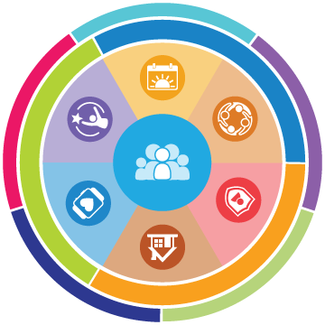
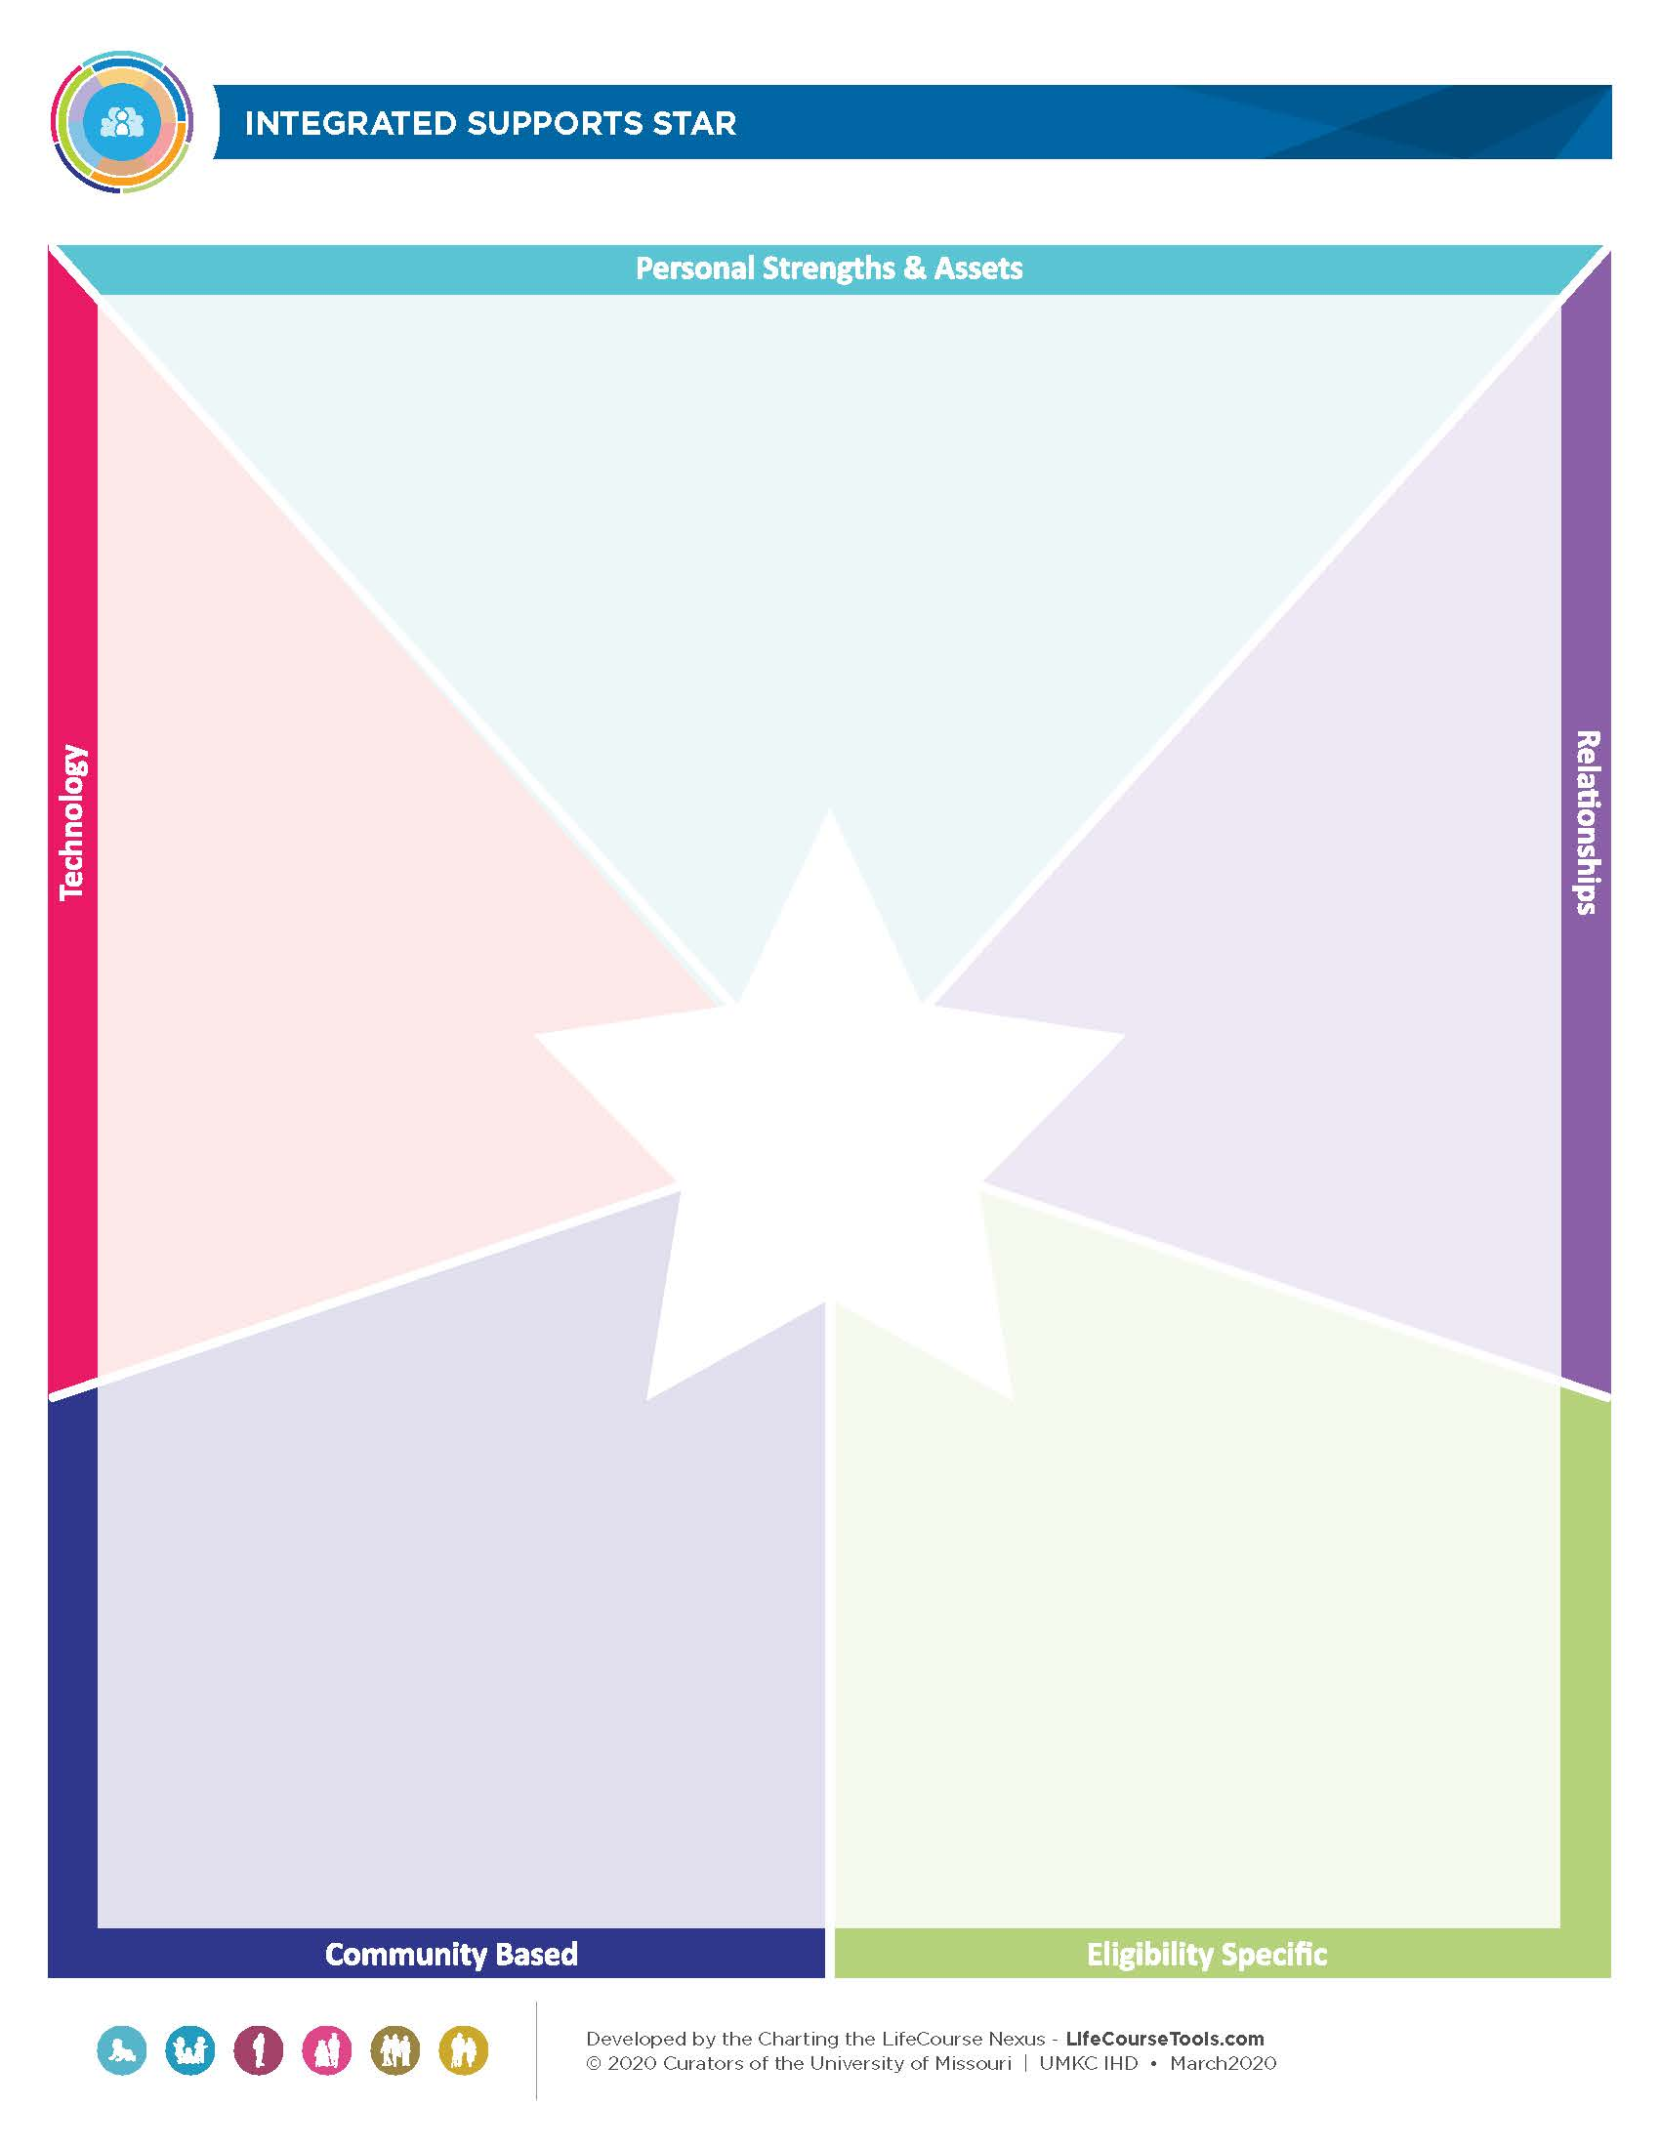
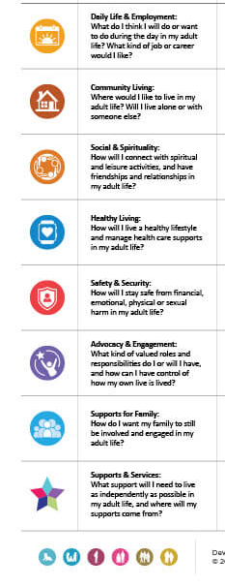
Assessing Person-Centered Needs: CtLC
Integrated Support Star
Vision Tool
Notes:
Amanda
Integrated Support Star
Used to identify services and supports the person has and gaps
Vision Tool
Used to assess their vision of a good life – person and family centered interests/needs
More to come on these from Jenny Turner – Assistant Director, LifeCourse Nexus Training and TA Center

Slide 11
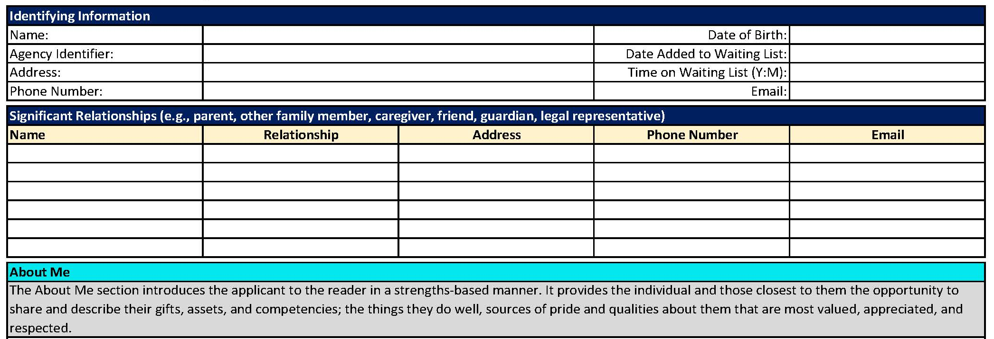
Service Navigation – Bringing Services to the Applicant
Notes:
Amanda
Hit the purpose of the navigation plan
Starts with information about the applicant

Slide 12
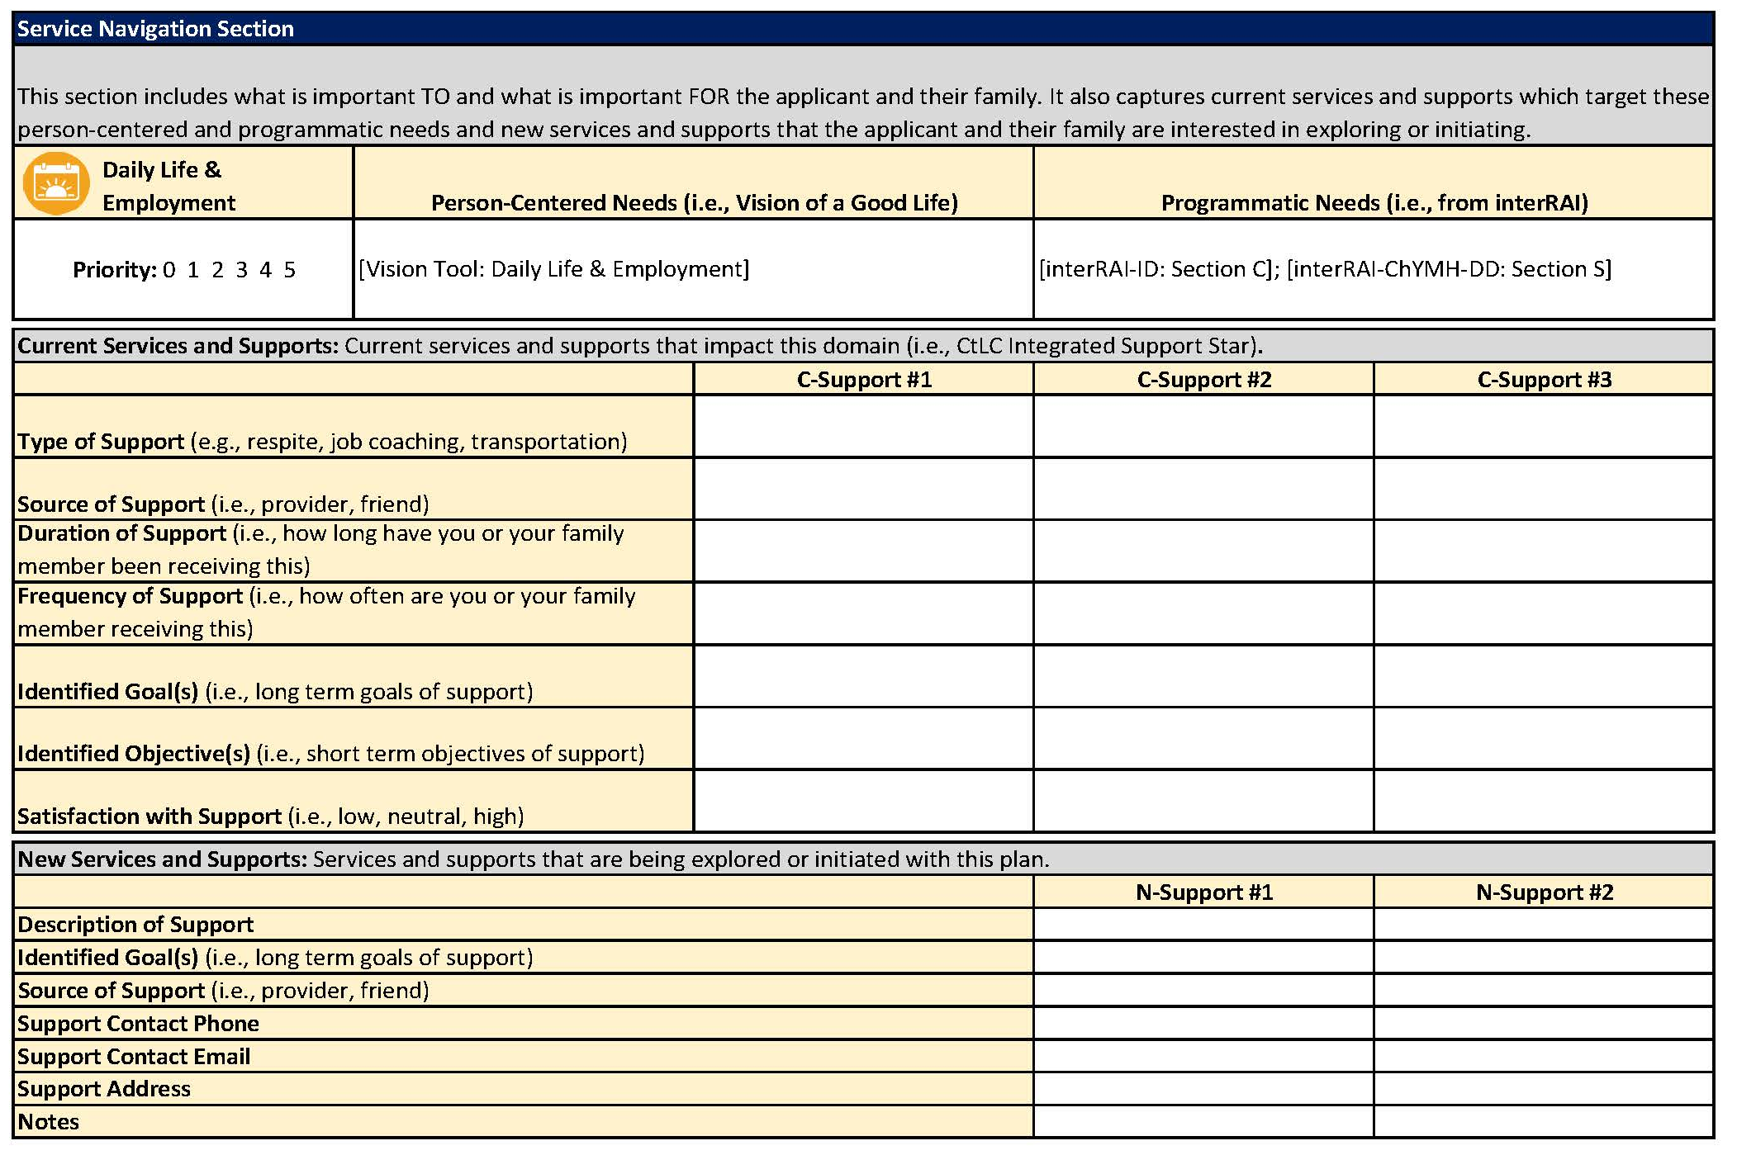
Notes:
Amanda
Organized by CtLC Life Domains
Person-Centered and Programmatic Needs
Current (C) Services and Supports (from documents and Integrated Support Star)
New (N) Services that the applicant may benefit from, and is interested in
SAMPLE ON THIS SLIDE FOR 1 DOMAIN

Slide 13
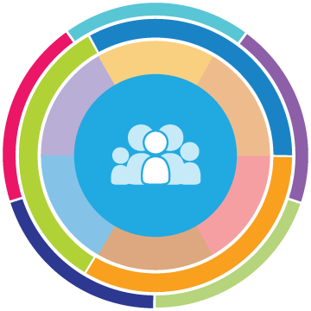
What is
Charting the LifeCourse
Guiding Framework
Key principles and icons to guide thinking
Practices
Specific action, policy, or procedure
to enhance or change
Tools
Resources for informing,
Planning &
Problem-solving

Slide 14
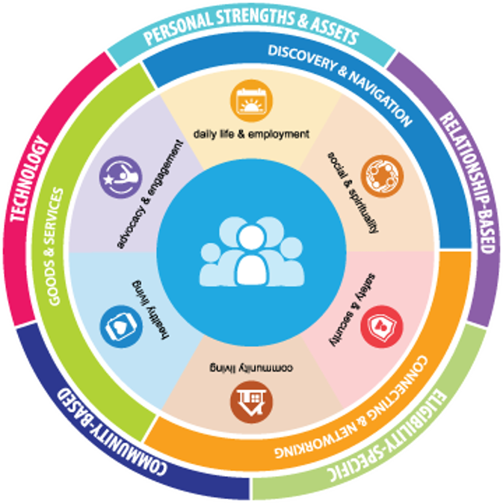
What is Charting the LifeCourse ?
Created for people and families of all abilities and all ages to:
Explore life possibilities
Share ideas, hopes, and fears
Set higher expectations
Navigate Future
Advocate for Vision
Problem-Solve and Plan

Slide 15
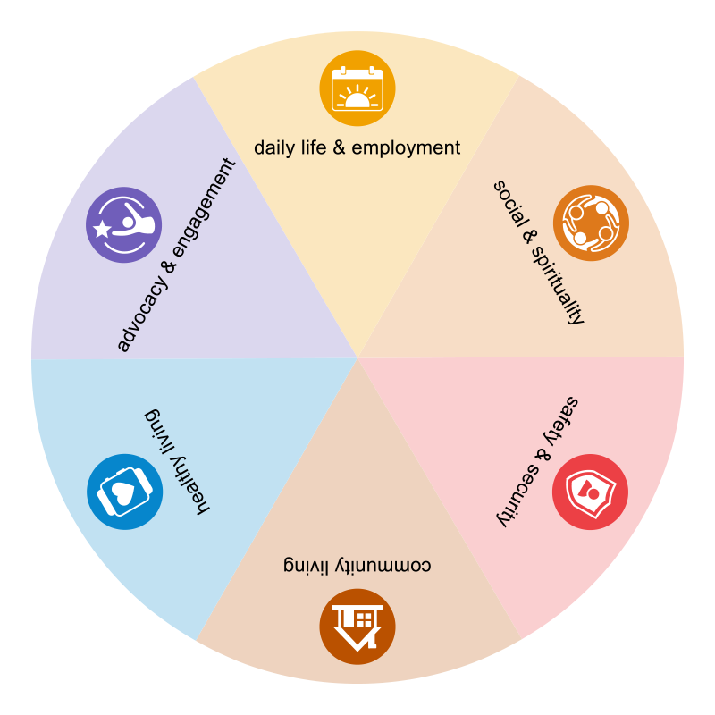








Slide 16
Vision & Trajectory for a Good Life
Friends, family,
enough money,
job I like, home, faith, vacations, health, choice, freedom
Trajectory towards Life Outcomes
Poverty, abuse, boredom, lack of control, no sense of purpose, isolation
Trajectory towards things unwanted
Notes:
What kinds of things do you want for YOUR good life? PWD and families usually want those same types of things. Everybody “gets” what the good life is. We just don’t usually ask them! What kinds of things do you think PWD and families will say they DON’T want? Sometimes you need to start there – they may not know what they want (because they are thinking in disability world) but they almost always can tell you want they don’t. FAMILY should have a good life trajectory too.
TRAJECTORY is the path that will either lead you toward the good life or toward things you don’t want. Think about throwing a football – the path that the ball takes on it’s way to the receiver is the trajectory. If you shoot an arrow, or a nerf gun – the path that the arrow follows is the trajectory. YOU CAN START at ANY AGE!!!!
Support coordinators, providers, Direct Support Professionals, Vocational Rehabilitation counselors, teachers….. ALL have the power to impact someone’s trajectory, sometimes it’s a positive impact, but also sometimes negatively, y their actions or words. We must be very careful and mindful of the impact we can have. Are we nudging the person and family toward what they want or what they don’t want?? EACH interaction, think about which way it nudged their trajectory!
Insert a story here if you have one
For example - KINDERGARTEN story – segregated class and “safer” special bus – but what trajectory is that putting the kindergartner on?
Trajectory isn’t always straight
We all have bumps in the road (lose a job, get a divorce, illness, etc. – you can get back on track
VISION and TRAJECTORY can be very broad or very specific and time limited. Might be what are we doing/what’s happening this week, or around a specific topic or life issue (lose weight, buy a house, etc)

Slide 17






Focusing on All Life Domains
Daily Life and Employment
(school/education, employment, volunteering, routines, life skills)
Healthy Living
(medical, behavioral, nutrition, wellness, affordable care)
Community Living
(housing, living options, home adaptations and modifications, community access, transportation)
Safety and Security
(emergencies, well-being, legal rights & issues, guardianship options & alternatives )
Advocacy and Engagement
(valued roles, making choices, setting goals, responsibility, leadership, peer support)
Social and Spirituality
(friends, relationships, leisure activities, personal networks, faith community)
Notes:
Explain each domain. They are all interrelated and connected. The service system tends to want to focus only on health and safety.
Cocktail party conversations…
Quality of life areas!!

Slide 18
Using Life Domains to Understand, Narrow, Pinpoint the Vision
Life Domain Vision Tool: Person Centered

Slide 19
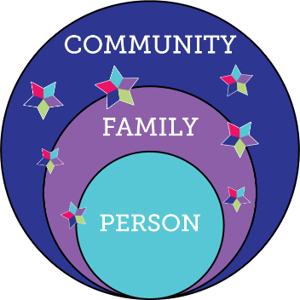
Charting the LifeCourse Integrated Supports Star

Slide 20
Ways You Can Use the Star Principle
Exploring
Problem-solving
Planning
Your Name or a Specific Goal

Slide 22


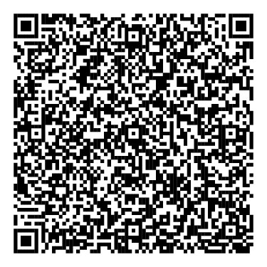






Meet the Team
Contact Liberty Healthcare Corporation to arrange a time to discuss our solutions that you can take advantage of.
Christopher Baglio, Vice President, Program Development
Contact Oklahoma Developmental Disabilities Services Division (DDSD) to learn more about Oklahoma’s waitlist transformation and explore opportunities within your state.
Beth Scrutchins, DDSD Director
beth.scrutchins@okdhs.org
Visit Liberty Healthcare’s NASDDDS booth and talk with one of our Charting the LifeCourse (CtLC) Ambassadors.
chris.baglio@libertyhealth.com (317) 677-6631
Add me to your contacts
NOVEMBER 10
Wednesday
10:00 – 11:00 AM EST
1:00 – 2:00 PM EST
3:00 – 4:00 PM EST
Notes:
Once you get to this slide, we would then answer some questions if there are any posed.

